Slide 1

SpotCheckAI: Sprint 2 Presentation
Rafferty Leung

Slide 2
Improvements made from feedback
API Slide Inclusion- Slide 38

Slide 3
Agenda
Team Member Roles and Responsibilities
Problem Statement/Description
Team Working Agreement
Personas
Minimum Viable Product
Technologies Implemented
Algorithms Employed
Diagrams
Product Backlog
Sprint 2 Backlog
Metrics
Retrospective
Sprint 2
MVP Demo

Slide 4
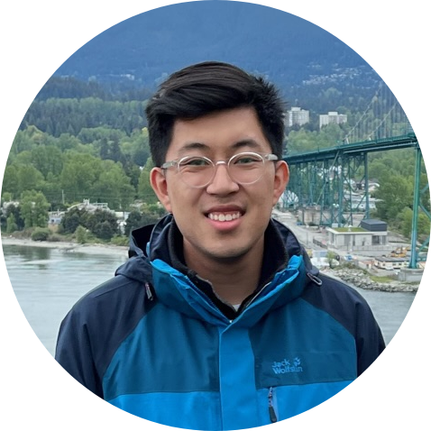
Team Roles and Responsibilities
Responsibilities:
Write and test code to ensure high-quality software that meets requirements.
Troubleshoot and debug code to identify and fix issues.
Ensure software scalability, performance, and security.
Work with project managers to estimate development efforts and deliver on time.
Define and prioritize the product roadmap and features based on user needs and market trends.
Gather and analyze user feedback and market research to inform product decisions.
Create and manage product requirements and specifications.
Rafferty Leung
Software Engineer, Product Manager

Slide 5
Problem Statement
The average wait time to see a physician is currently 26 days, and the process of diagnosing skin cancer can cause delays in treatment due to the need for a dermatology appointment, visual inspection, and pathology review. To address this issue, a proposed solution involves using machine learning algorithms to triage patients based on skin lesion images. This approach has the potential to identify cases with a higher certainty of being cancerous, allowing those patients to be prioritized for earlier appointments and reducing wait times while improving patient outcomes.

Slide 6
Project Description
For individuals concerned about the potential malignancy of skin lesions,
who want a faster and more convenient alternative to traditional diagnostic methods,
the SpotCheckAI progressive web application (PWA)
is a solution
that allows users to upload an image and receive a response that predicts the likelihood of the lesion being cancerous or benign, providing preliminary responses to the end-user and streamlining a physician’s practice
unlike existing solutions that may have limited accuracy or accessibility,
our application’s machine learning model provides a highly accurate and user-friendly experience with the added benefit of being open source, allowing for further development and improvement of the machine learning model.

Slide 7
Team Working Agreement
Participation
It is expected of all members of the team to arrive promptly for meetings and actively participate during the meeting.
Daily participation in the sprint cycles is required.
Communication
The team will utilize Slack, LinkedIn Messaging, or Email for communication, ensure codebase maintenance, and uphold transparency by openly addressing any obstacles or concerns they encounter.
Work Division
The distribution of work and project responsibilities will be fair and equal, and each sprint will reflect this approach.

Slide 8
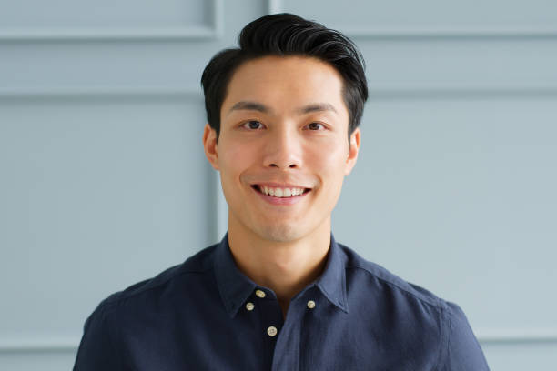
Persona 1
Name: David Kim
Age: 42
Occupation: Construction Project Manager
Education: Bachelor's degree in Civil Engineering
Personality: David is a hard-working and responsible individual who takes pride in his work. He is a detail-oriented person who pays close attention to his surroundings and is always looking for ways to improve processes. He is also health-conscious and enjoys staying active by jogging and playing basketball with his friends.
Interests: David is interested in technology and enjoys exploring new apps and software. He is also an advocate for sun safety and spends a lot of time outdoors due to his job, which has increased his risk of skin cancer. He enjoys learning about new ways to protect his skin and stay healthy.
Goals: David's main goal is to excel in his career and take on larger construction projects. He also wants to continue leading an active and healthy lifestyle, which includes monitoring his skin for signs of skin cancer. He hopes to use technology to help him achieve his health goals and stay informed about the latest developments in sun protection.
Challenges: David faces challenges in balancing his demanding job with his personal life. He also struggles with keeping track of his skin health, as it can be difficult to remember to check his skin for changes regularly. He hopes to use a skin cancer detection app to help him monitor his skin and catch any potential issues early on. However, he is also concerned about the accuracy of such apps and wants to ensure that he is using a reliable and trustworthy tool.

Slide 9

Persona 2
Name: Emily Rodriguez
Age: 29
Occupation: Outdoor Recreation Guide
Education: Associate's degree in Outdoor Recreation
Personality: Emily is a nature enthusiast who is passionate about sharing her love of the outdoors with others. She is outgoing and adventurous, and enjoys exploring new trails and camping sites. She is also conscientious and takes her responsibility for the safety of her clients seriously.
Interests: Emily enjoys hiking, backpacking, and rock climbing in her free time. She is also interested in technology and is always looking for ways to use it to enhance her clients' experiences. She is particularly interested in skin cancer prevention and is looking for ways to incorporate sun safety into her job.
Goals: Emily's main goal is to help her clients have a safe and enjoyable experience in the great outdoors. She also hopes to use technology to help her monitor her own skin health and catch any potential issues early on. Additionally, she wants to continue exploring new outdoor adventures and sharing them with others.
Challenges: Emily faces challenges in keeping track of her skin health while spending long hours outdoors. She hopes to use a skin cancer detection app to help her monitor any changes in her skin but is concerned about the reliability of such tools. She also struggles with work-life balance at times, as her job requires her to spend long hours in the outdoors.

Slide 10

Persona 3
Name: Thomas Lee
Age: 45
Occupation: Sales Manager
Education: Bachelor's degree in Marketing
Personality: Thomas is a confident and charismatic person who enjoys interacting with people. He is skilled at building relationships and is always looking for ways to improve his sales numbers. He is also health-conscious and takes his sun safety seriously.
Interests: Thomas enjoys playing golf and is a member of a local golf club. He also enjoys traveling with his family and experiencing new cultures. He is interested in technology and is always looking for ways to use it to improve his work and personal life.
Goals: Thomas's main goal is to increase his sales and advance in his career. He also hopes to use technology to help him monitor his skin health and catch any potential issues early on. Additionally, he wants to continue playing golf and spending time with his family.
Challenges: Thomas faces challenges in keeping track of his skin health while spending long hours outdoors meeting with clients. He hopes to use a skin cancer detection app to help him monitor any changes in his skin but is concerned about the accuracy of such tools. He also struggles with work-life balance at times, as his job requires him to travel frequently and spend long hours working.

Slide 11
Minimum Viable Product
A website that allows for simple input and output with a predicted degree of certainty.
Implementation of a Machine Learning Model with sufficient testing and training sample size.
A cross-platform website that is responsive and device agnostic.
Chatbot for answering questions.

Slide 12
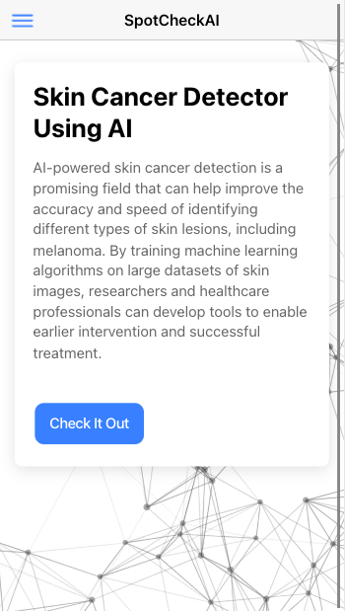
MVP: Home Page
Overview of what application’s functionality
Prediction form accessibility

Slide 13
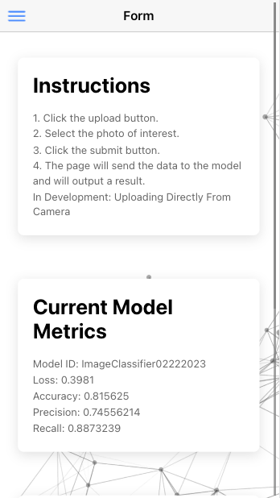
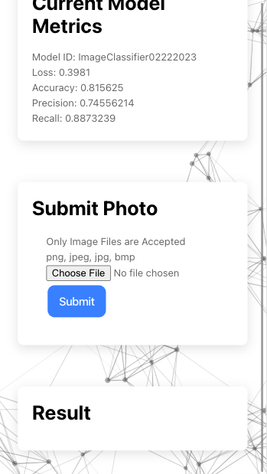
MVP: Prediction Form
Instructions
Current Model Metrics
Submit Photo
Specified image type criteria
Result
Will return result with prediction or HTTP Error Message

Slide 14
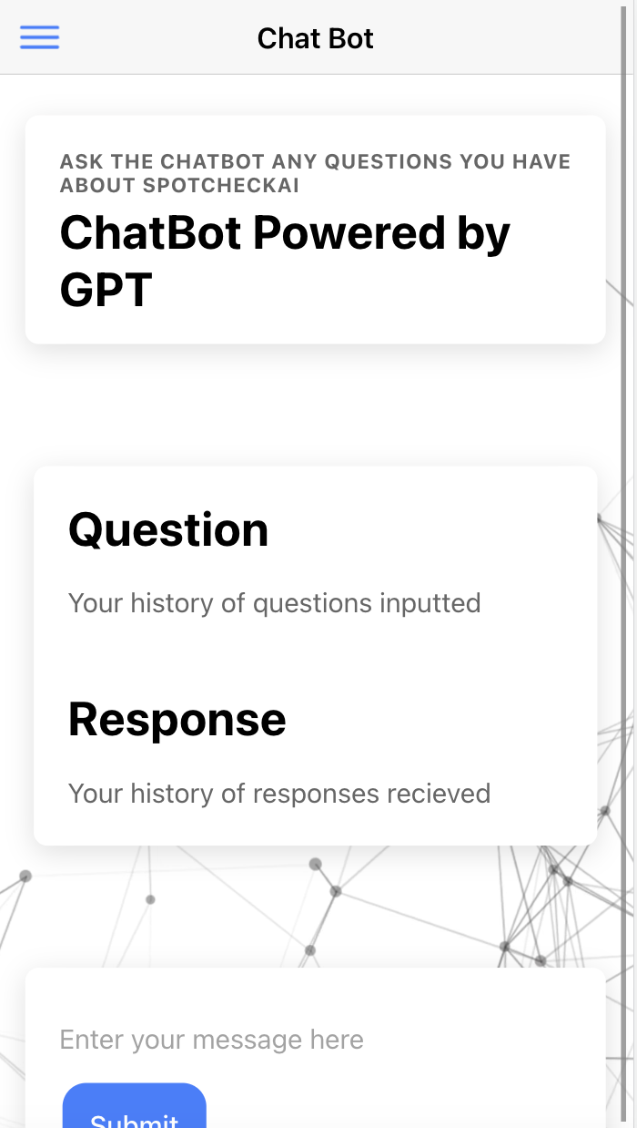
MVP: Chatbot
Questions and Answers Generated by ChatGPT

Slide 15

Current Technologies Utilized

Slide 16

Algorithm: CNN
Image Recognition → Convolution Neural Network
Three separate ”stacks” of 2D layers:
Convolution Layer with ReLU activation
Max Pooling Layer
Drop Out Layer
Flatten Layer
Dense Layer
SpotCheckAI uses ResNet50

Slide 17
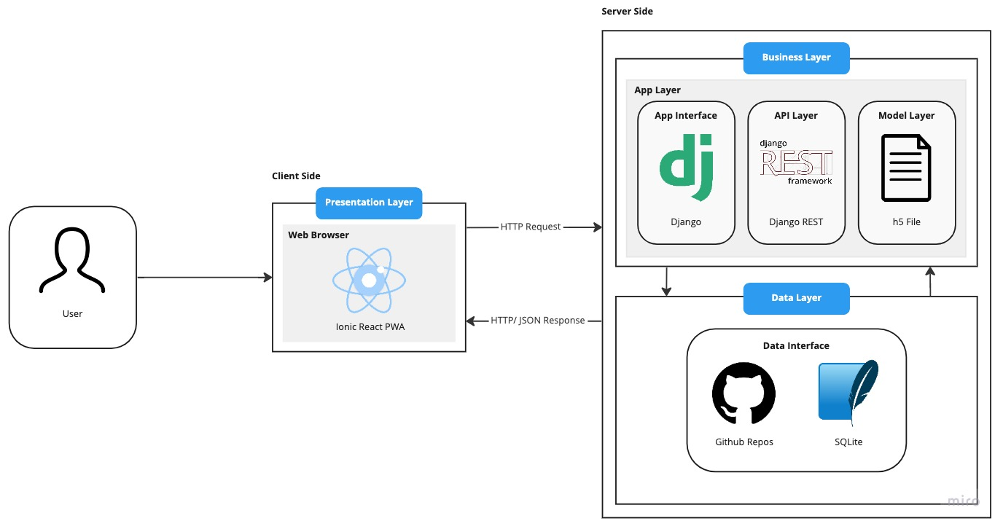
Diagrams: Architecture

Slide 18
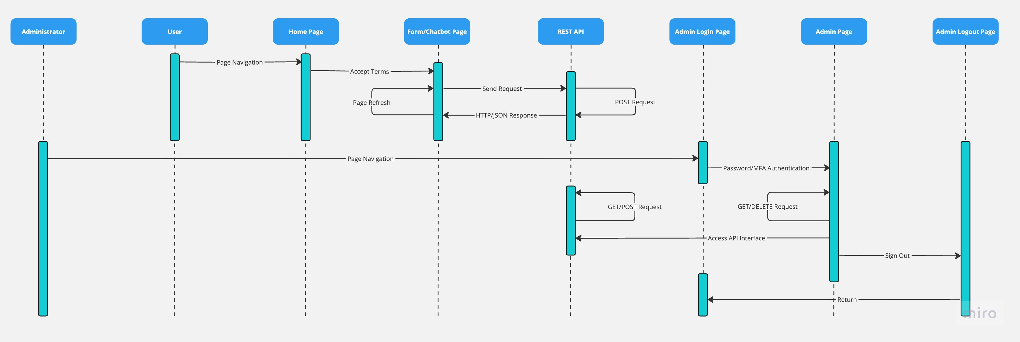
Diagrams: User Sequence

Slide 19
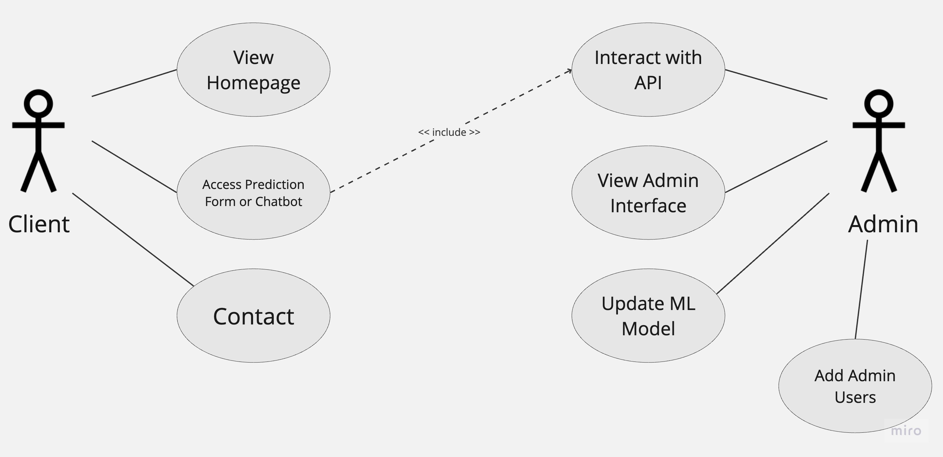
Diagrams: Use Case Diagram

Slide 20
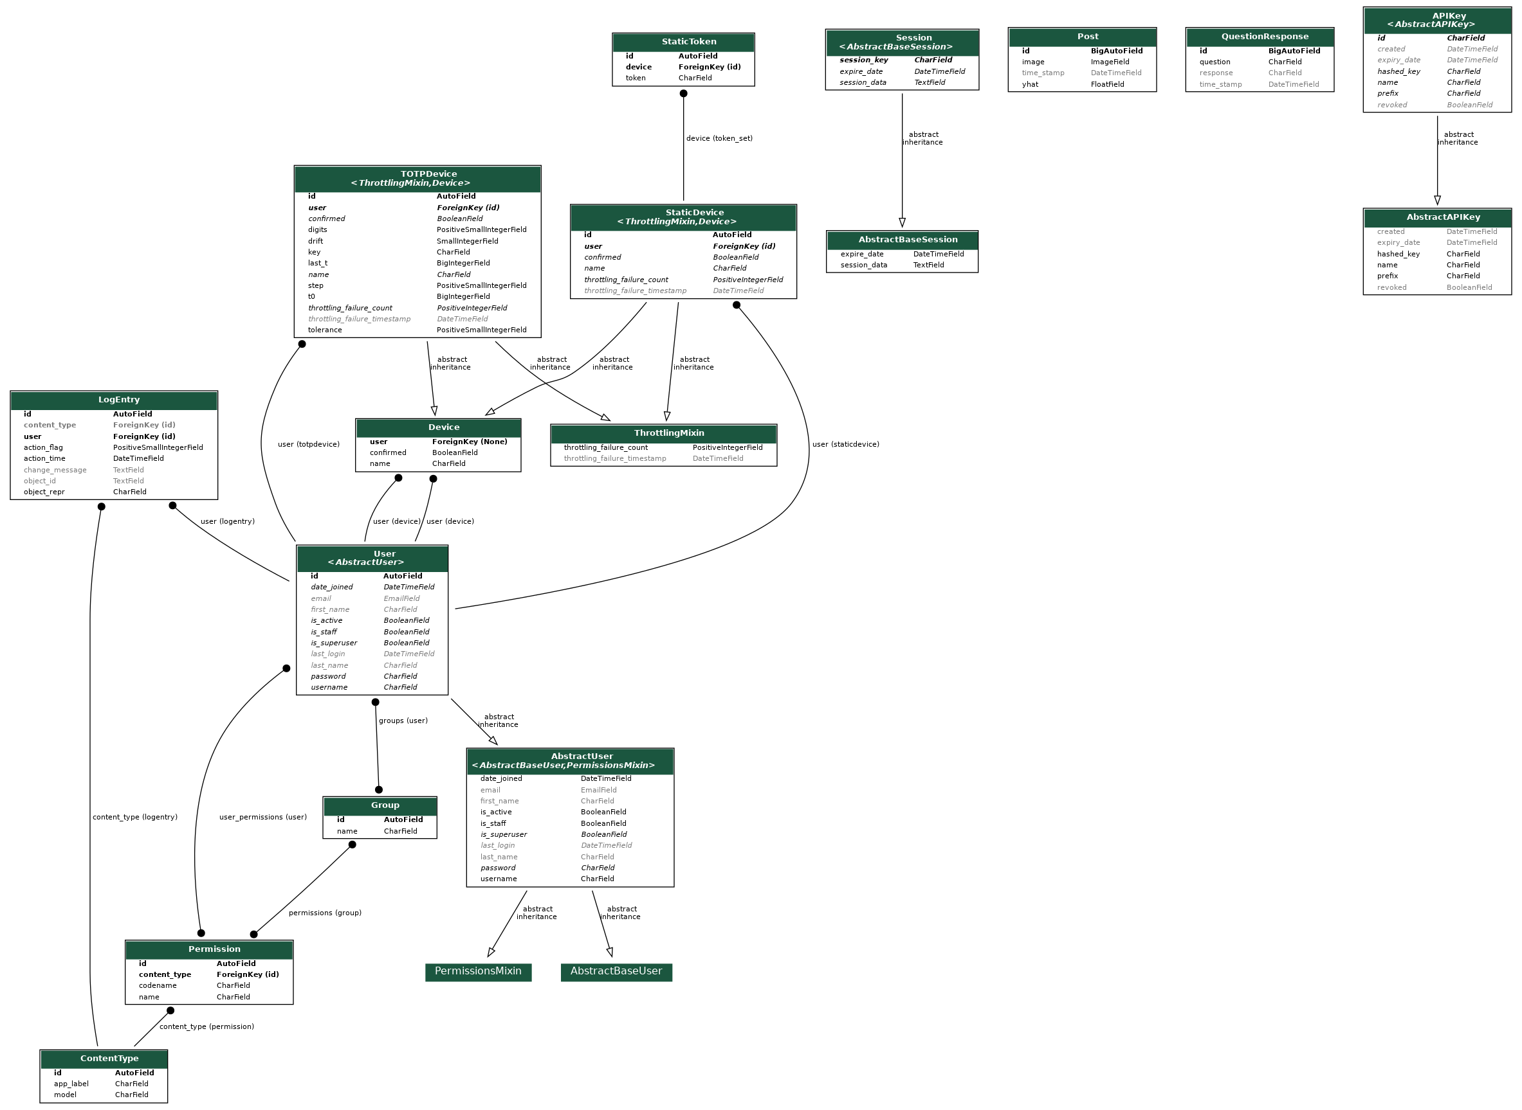
Diagrams: Class Diagram

Slide 21
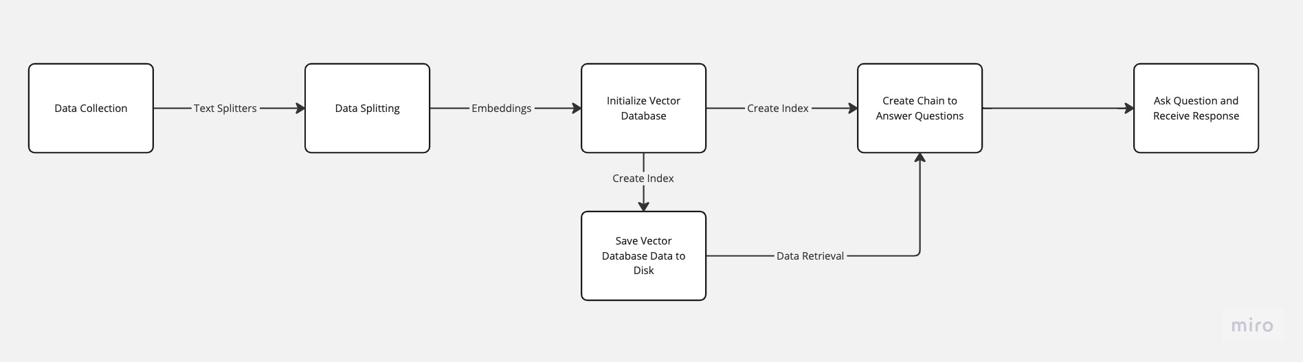
Diagrams: Process Flow of Chatbot

Slide 22
Sprint 1 Recap
MVP creation
Simple application that could send and receive a response based off of a simple machine learning model
Issue Type | Key | Description
Story | CAP-37 | As a user I want to be able to use this on any device so that it is convenient to use.
Story | CAP-41 | As a user I want to be warned that this does not replace a physician and that I should know that before using it so that I know the limitations of this software.
Story | CAP-42 | As a user I want to interface to be easy to understand so that I don’t have to Google more information about what information I am looking at.
Story | CAP-43 | As a user I want my data to be protected so that my data and information is private.

Slide 23
Product Backlog
Issue Type | Key | Description
Story | CAP-44 | As a user I want to take a photo and send it without having the photo save to my phone first
Story | CAP-40 | As a user I want this to have reliable and provide information about the data
Story | CAP-39 | As a user I want to have instant feedback as well as detailed feedback
Story | CAP-38 | As a user I want to chat with someone or find out more information regarding the website
Task | CAP-30 | Implement Ion Loading
Task | CAP-3 | Add a new model to optimize
Task | CAP-4 | Add more training data
Task | CAP-9 | Implement Back End Web Hosting
Task | CAP-10 | Implement Front End Web Hosting
Task | CAP-14 | Enforce consistent coding style
Task | CAP-15 | Unit testing: Back End
Task | CAP-16 | End-to-End testing: Front End
Task | CAP-17 | End-to-End testing: Back End
Task | CAP-27 | Capacitor/Cordova Implementation
Task | CAP-28 | Add API Key
Task | CAP-35 | AWS S3 Buckets

Slide 24
Catalyst 2 Backlog
Issue Type | Key | Description
Story | CAP-44 | As a user I want to take a photo and send it without having the photo save to my phone first
Story | CAP-40 | As a user I want this to have reliable and provide information about the data
Story | CAP-39 | As a user I want to have instant feedback as well as detailed feedback
Story | CAP-38 | As a user I want to chat with someone or find out more information regarding the website
Task | CAP-30 | Implement Ion Loading
Task | CAP-3 | Add a new model to optimize
Task | CAP-4 | Add more training data
Task | CAP-9 | Implement Back End Web Hosting
Task | CAP-10 | Implement Front End Web Hosting
Task | CAP-14 | Enforce consistent coding style
Task | CAP-15 | Unit testing: Back End
Task | CAP-16 | End-to-End testing: Front End
Task | CAP-17 | End-to-End testing: Back End
Task | CAP-27 | Capacitor/Cordova Implementation
Task | CAP-28 | Add API Key
Task | CAP-35 | AWS S3 Buckets

Slide 25
User Stories and Acceptance Criteria
User Story ID | Summary | Status | Place
CAP-37 | As a user I want to be able to use this on any device so that it is convenient to use. Scenario: User visiting website for the first time Given I am a role of a user When I visit this website Then I want this page to adapt to what device I am using. | Done | Platform
CAP-41 | As a user I want to be warned that this does not replace a physician and that I should know that before using it so that I know the limitations of this software. Scenario: Anxious user who is health conscious Given I am a role of a user When I am about to upload an image for prediction Then I want this page to warn me about its limitation | Done | Webpage
CAP-42 | As a user I want to interface to be easy to understand so that I don’t have to Google more information about what information I am looking at. Scenario: First time user Given I am a role of a user When I visit this webpage Then I want this page have clear information And easy to digest information for a non-medical professional | Done | Webpage
CAP-43 | As a user I want my data to be protected so that my data and information is private. Scenario: A concerned user about their data Given I am a role of a user When using this webpage Then I want my data I send into the website to be deidentified and unlabeled with my information. | Done | Platform
CAP-44 | As a user I want to take a photo and send it without having the photo save to my phone first. Scenario: Native-like use application Given I am a role of a user When I visit this webpage Then I want this page to be seamless and integrated with my phone/device | Incomplete | Platform
CAP-40 | As a user I want this to have reliable and provide information about the data Scenario: First time user Given I am a role of a user When I visit this webpage Then I want this page tell me what my results mean | Complete | Webpage
CAP-39 | As a user I want to have instant feedback as well as detailed feedback Scenario: User sends photo Given I am a role of a user When I visit this webpage Then I want this page to display feedback so that I can understand my result | Complete | Webpage
CAP-38 | As a user I want to chat with someone or find out more information regarding the website Scenario: User has questions Given I am a role of a user When I visit this webpage Then I want this page to have someone available to "speak" with | Complete | Webpage

Slide 26
Test Cases
User Story ID | Unit to Test | Assumption | Test Data | Steps to be Executed | Expected Results
CAP-40 | Front End | Data displayed will be intuitive | Test image | Upload Image → Obtain Response | Result should be the same on the front end and back end
CAP-38 | Chat Bot | User will have questions about the website | User query | Ask question → Returns valid response | Valid response returned
CAP-3 | ML Model | ML model will output binary confidence level | Image not seen by model before | Ipynb --> Add Image --> Check Result | Result is between 0 - 1

Slide 27
Stories Completed
Issue Type | Key | Description
Story | CAP-40 | As a user I want this to have reliable and provide information about the data
Story | CAP-39 | As a user I want to have instant feedback as well as detailed feedback
Story | CAP-38 | As a user I want to chat with someone or find out more information regarding the website

Slide 28
Stories Incomplete
Issue Type | Key | Description
Story | CAP-44 | As a user I want to take a photo and send it without having the photo save to my phone first.

Slide 29
Team Velocity

Slide 30
Historical Velocity

Slide 31
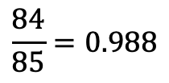
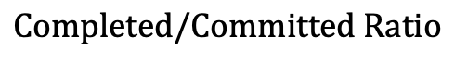
Completed/Committed Ratio
$$Completed/Committed Ratio$$
$$\frac{84}{85}=0.988$$

Slide 32
Burndown Chart

Slide 33
Retrospective

Slide 34
What Went Well
01
Version control and use of Git
02
Completed program works end-to-end
03
Despite a tight schedule, the work was completed on time and the minimum viable product (MVP) was successfully implemented.

Slide 35
What Needs Improvement
01
More time spent on the specific execution of the sprint cycle (ie. day by day planning for progress)
02
Detailed documentation within codebase for easier recall, coding style enforcement.

Slide 36
Sprint 3
Application is complete and ready to be hosted on the web

Slide 37
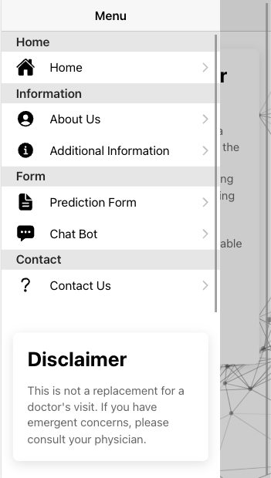
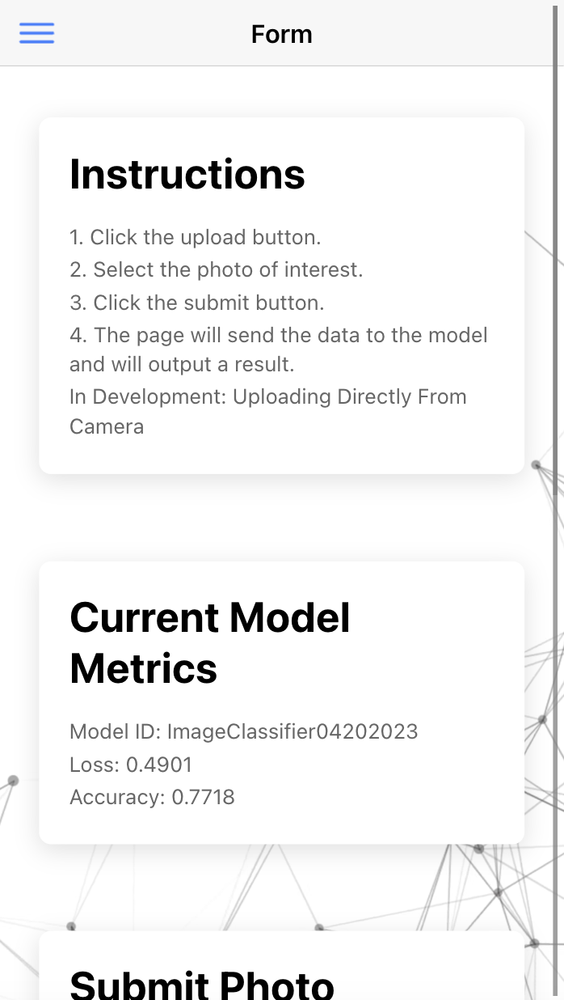
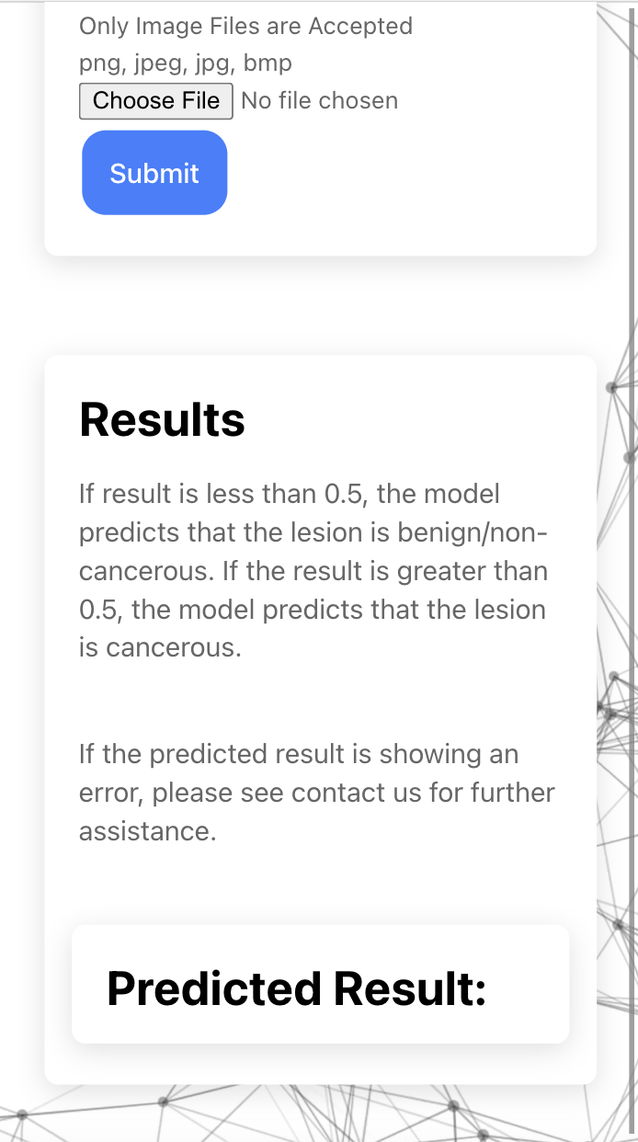
Application Screenshots

Slide 38
API- Backend
REST API written in Python
Django REST Framework
Two endpoints:
ML Model Prediction
Chatbot
Admin Interface

Slide 39
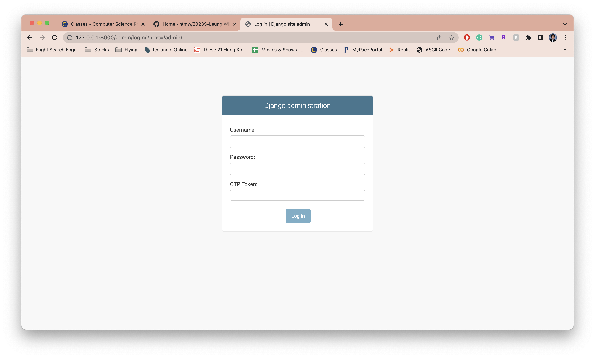
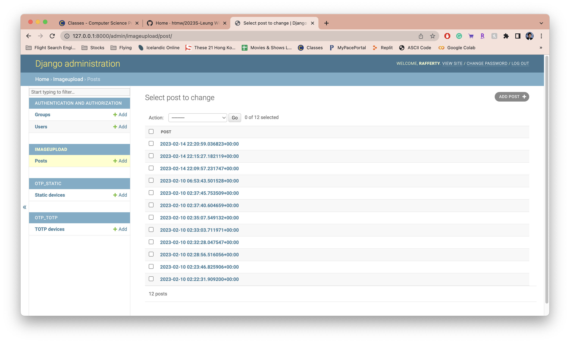
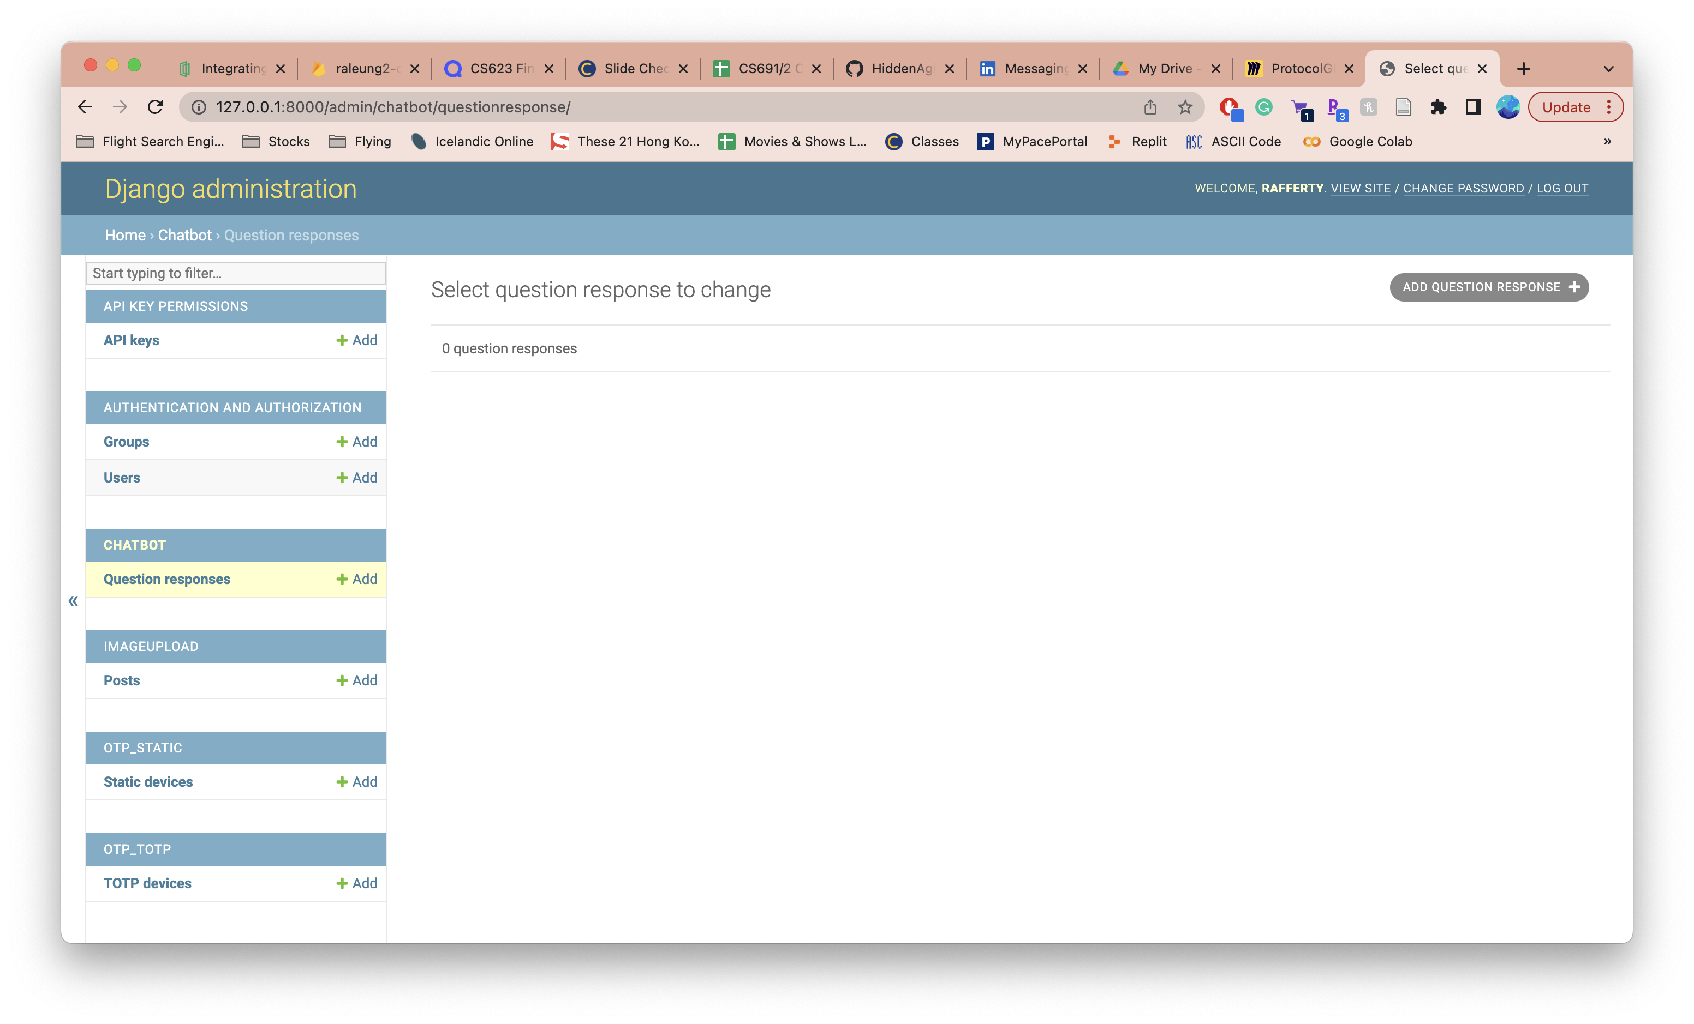
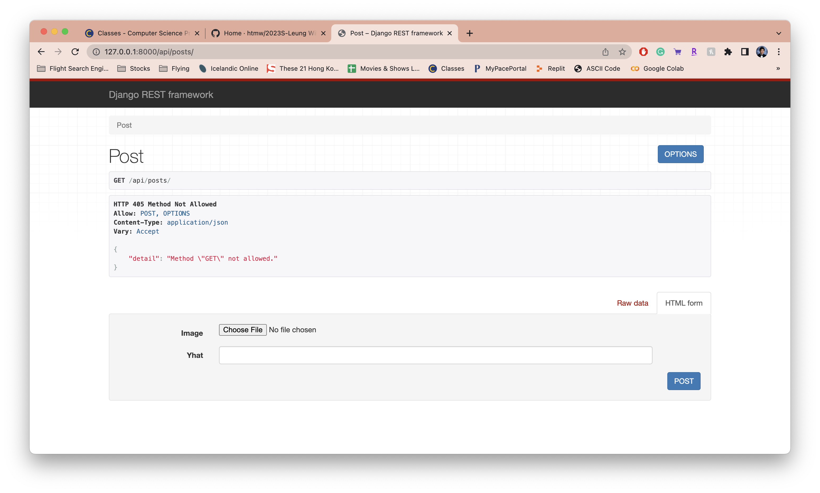
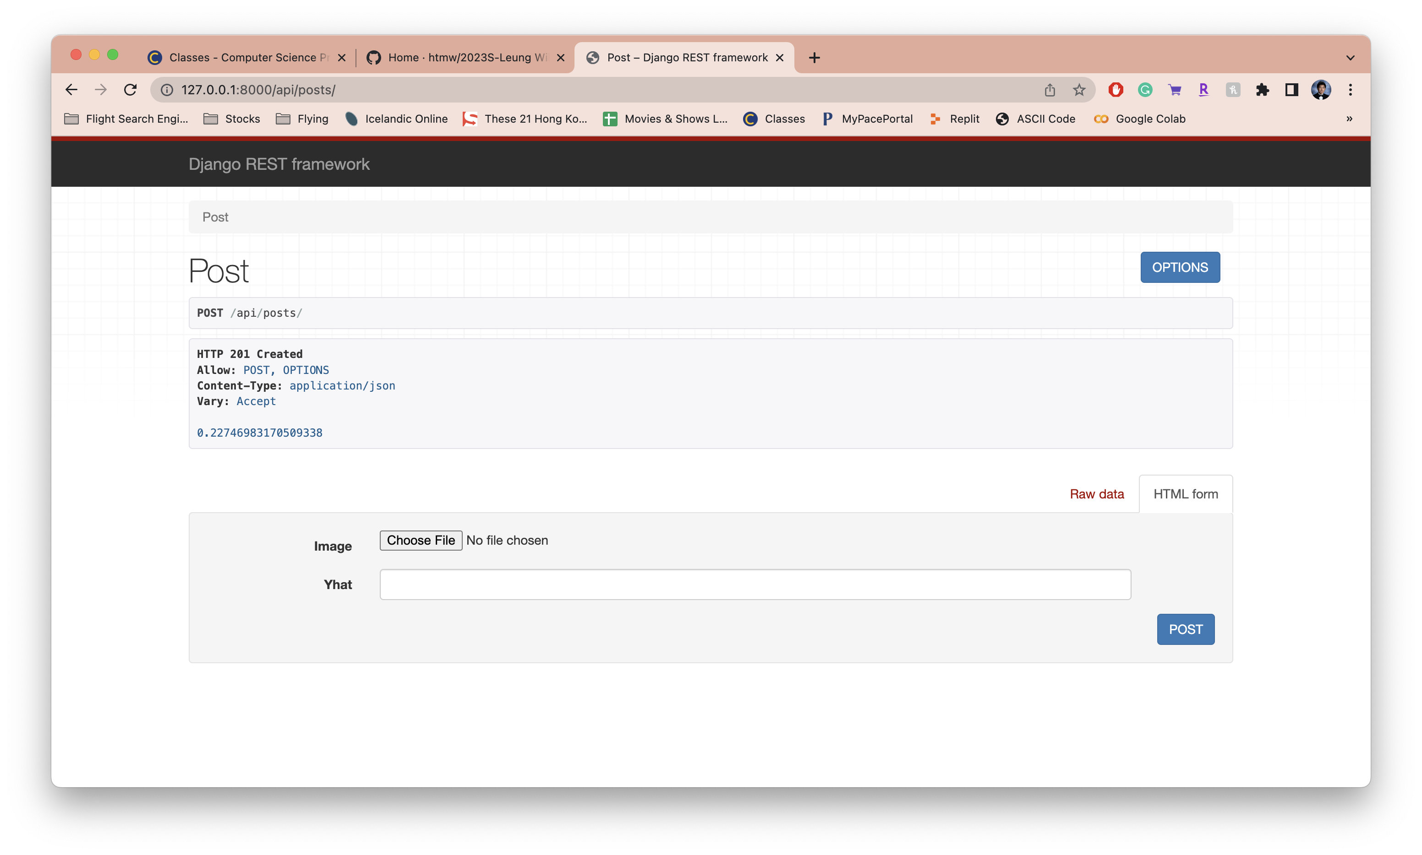
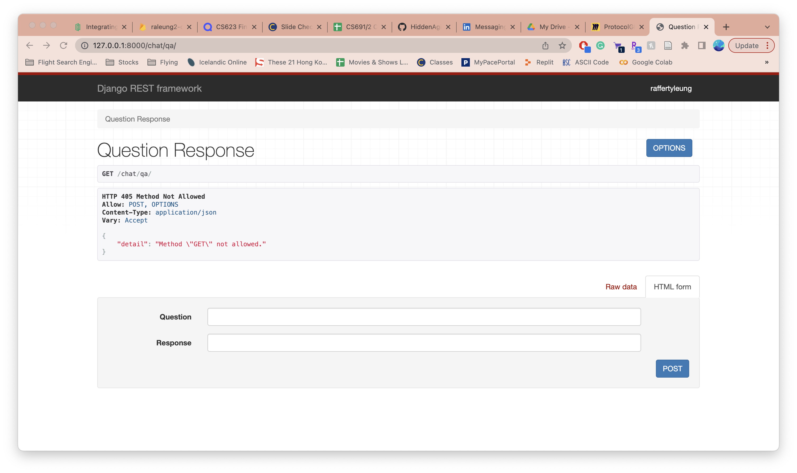
API Screenshots

Slide 40
Links
GitHub: https://github.com/htmw/SpotCheckAI/wiki
MVP Video: https://youtu.be/ZlA84M-7EZ8

